Slide 1
Facial Image Analysis Using Fixed Position Dynamic Size Block: Application in Face and Gender Recognition
Presented By Md. Mostafijur Rahman BSSE-0312
Supervised By
Dr. Mohammad Shoyaib
Associate Professor
IIT, University of Dhaka

Slide 2






Points to be Ponder
Motivation
Problem Statement
Solution Direction
Proposed Method
Experimental Result
Conclusion

Slide 3
Motivation
Many application areas
Face, gender, expression recognition, age estimation.
Recent studies show
Market size of face recognition base applications will reach at $6.5 Billions within 2018[1].
Compound Annual Growth Rate (CAGR) of 27.7% from 2013 to 2018. [1].
Mainly two approaches of facial image analysis
Holistic approaches are fast and provide reasonable accurate result
Existing methods fails due to size and pose variation

Slide 4
Basic steps in recognition system using facial image
Image Acquisition
Face Detection
Block Definition
Feature Extraction
Classification
Figure 1: Steps in recognition systems using facial image

Slide 5
Problem Statement
Recognition rate falls down due to pose and size variation while using
Holistic Method (Whole face information) and
Uniform Blocking

Slide 6

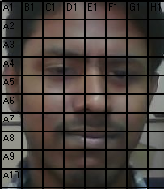

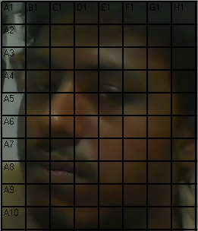

Problem Statement (cont.)
27
28
30
31
26
28
29
38
39
37
(a) Frontal face
(b)${60}^{o}$ rotated image
Figure 2: Uniform blocking
Figure 2: Same person in different pose

Slide 7
Solution Direction
Based on eyes, nose and mouth landmarks, we can divide faces into
Appropriate position
Dynamic size blocks

Slide 8
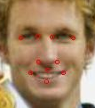
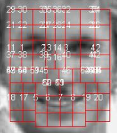




Proposed Method
Landmark Localization
Dynamic Size Blocking

Slide 9
Rules

Slide 10
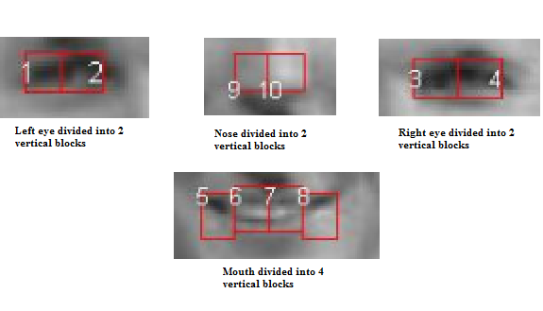
Rule 1
Eyes are divided into de = floor(sqrt(m)) vertical blocks
Mouth is divided into dm = ceil(sqrt(2m)) vertical blocks and
Nose is divided into dn = floor(sqrt(m)) blocks.
Figure 3: Rule 1 (8×8 blocking)

Slide 11
Rule 2 & 3
Left eye first block will be defined at B(log2(n), log2(m/2))th block using V(1) landmark.
Left eye last block will be defined at B(log2(n), log2(m/2) + de -1))th block using V (2) landmark.
Landmark V(1)
Landmark V(2)
Figure 4: Rule 2 & 3 (8×8 blocking)

Slide 12
Rule 4 & 5
Right eye first block will be defined at B(log2(n), m- log2(m/2))th block using V(3) landmark.
Right eye last block will be defined at B(log2(n), m-log2(m=2)+de - 1)th block using V(4) landmark.
Landmark V(3)
Landmark V(4)
Figure 5: Rule 4 & 5 (8×8 blocking)

Slide 13
Rule 6 & 7
Mouth start block will be defined at B(n-log2(n)/2, 3log2(m/2)/2)th block using V (5) landmark.
Mouth end block will be defined at B(n-log2(n)/2; 3log2(m/2)/2+dm-1)th block using V (6) landmark.
Landmark V(5)
Landmark V(6)
Figure 6: Rule 6 & 7 (8×8 blocking)

Slide 14
Rule 8 & 9
Nose start block will be defined at B(n-3log2(n)=2; 3log2(m/2)/2+1)th block using V(7) landmark.
Nose end block will be defined at B(n-3log2(n)/2; 3log2(m/2)/2 + dn)th block using V (8) landmark.
Landmark V(7)
Landmark V(8)
Figure 7: Rule 8 & 9 (8×8 blocking)

Slide 15

Rule 10
All other blocks depend on the blocks defined by the above rules (Rule 1-9).
Upper eye blocks
Between nose and mouth blocks
Lower eye blocks
Lower mouth blocks
Figure 8: Rule 10 (8×8 blocking)

Slide 16
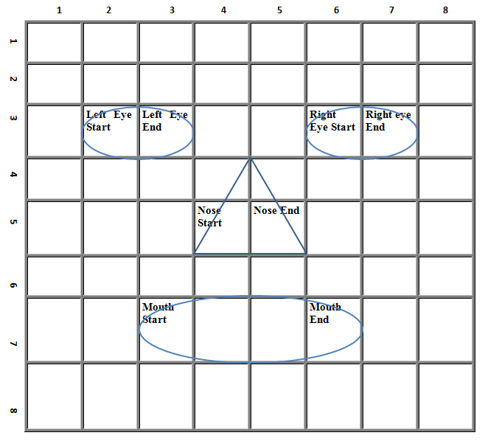
8×8 dynamic blocking
Figure 9: Pictorial Structure of 8×8 FPDSB

Slide 17

Histogram Normalization
$${bh}_{norm}\left(i\right)= \frac{100×bh(i)}{N_{b}}$$
Here, $N_{b}$ is the total number of pixel in the block, $bh(i)$ is the values of i’th histogram bin.

Slide 18
Experimental Result

Slide 19
Face Recognition Result
Table 1: Face Recognition Accuracy (8×8 FPDSB)
Feature | Uniform Block |  |  | FPDSB
 | Match (%) | Mismatch (%) | Avg. (%) | Match (%) | Mismatch (%) | Avg. (%)
LBP | 66.87 | 70.43 | 68.65 | 69.47 | 74.60 | 72.03
LTP | 67.77 | 72.27 | 70.02 | 69.97 | 74.83 | 72.40
LGP | 64.93 | 69.23 | 67.08 | 68.77 | 71.67 | 70.22

Slide 20
Face Recognition Result (cont.)
Table 2: Face Recognition Precision, Recall and F-measure (8×8 FPDSB)
Approach | TP | FP | FN | TN | Precision (%) | Recall (%) | F-measure (%)
LBP | 2006 | 994 | 887 | 2113 | 66.87 | 69.34 | 68.08
LTP | 2033 | 967 | 832 | 2168 | 67.77 | 70.96 | 69.33
LGP | 1948 | 1052 | 923 | 2077 | 64.93 | 67.85 | 66.36
LBP+FPDSB | 2084 | 916 | 762 | 2238 | 69.47 | 73.23 | 71.30
LTP+FPDSB | 2099 | 901 | 755 | 2245 | 69.97 | 73.55 | 71.72
LGP+FPDSB | 2063 | 937 | 850 | 2150 | 68.77 | 70.82 | 69.78

Slide 21
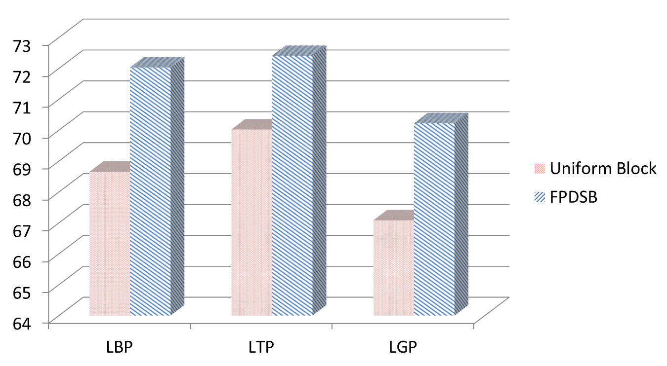
Face Recognition Result (cont.)
Recognition rate increased over 3%
Figure 10: Face Recognition accuracy (8×8 FPDSB)

Slide 22
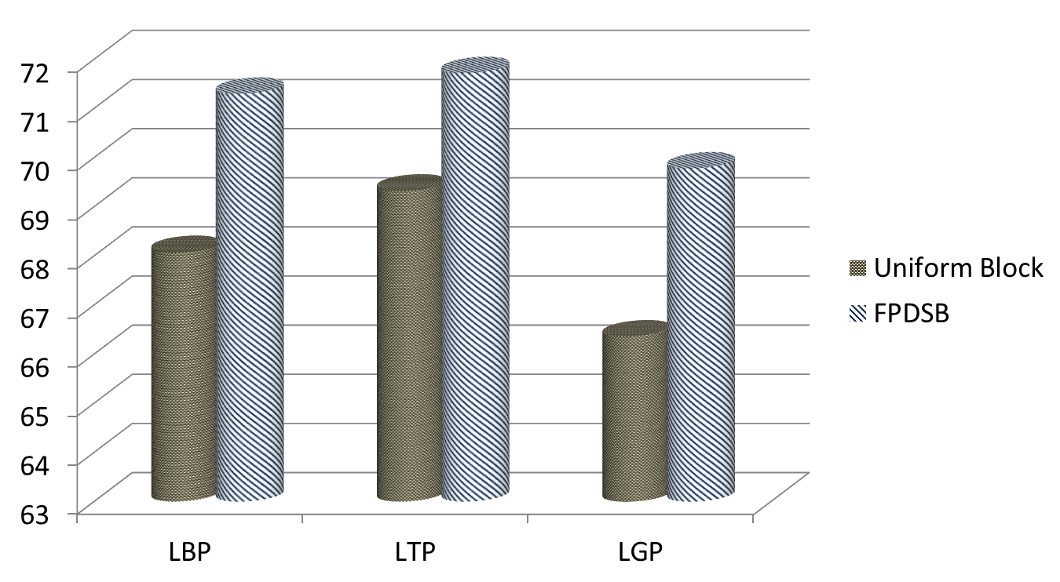
Face Recognition Result (cont.)
Figure 11: Face Recognition f-measure (8×8 FPDSB)

Slide 23
Gender Recognition Result
Table 3: Gender Recognition Accuracy (8×8 FPDSB)
Feature | Uniform Block |  |  | FPDSB
 | Male (%) | Female (%) | Avg. (%) | Male (%) | Female (%) | Avg. (%)
LBP | 95.02 | 73.61 | 90.21 | 96.49 | 83.03 | 93.46
LTP | 95.32 | 75.12 | 90.78 | 96.68 | 84.54 | 93.95
LGP | 94.54 | 71.43 | 89.34 | 96.39 | 82.69 | 93.31
Female Recognition rate increased over 10%

Slide 24
Gender Recognition Result (cont.)
Table 4: Gender Recognition Precision, Recall and F-measure (8×8 FPDSB)
Approach | TP | FP | FN | TN | Precision (%) | Recall (%) | F-measure (%)
LBP | 1948 | 102 | 157 | 438 | 95.02 | 92.54 | 93.76
LTP | 1954 | 96 | 148 | 447 | 95.32 | 92.96 | 94.13
LGP | 1938 | 112 | 170 | 425 | 94.54 | 91.94 | 93.22
LBP+FPDSB | 1978 | 72 | 101 | 494 | 96.49 | 95.14 | 95.81
LTP+FPDSB | 1982 | 68 | 92 | 503 | 96.68 | 95.56 | 96.12
LGP+FPDSB | 1976 | 74 | 103 | 492 | 96.39 | 95.05 | 95.72

Slide 25
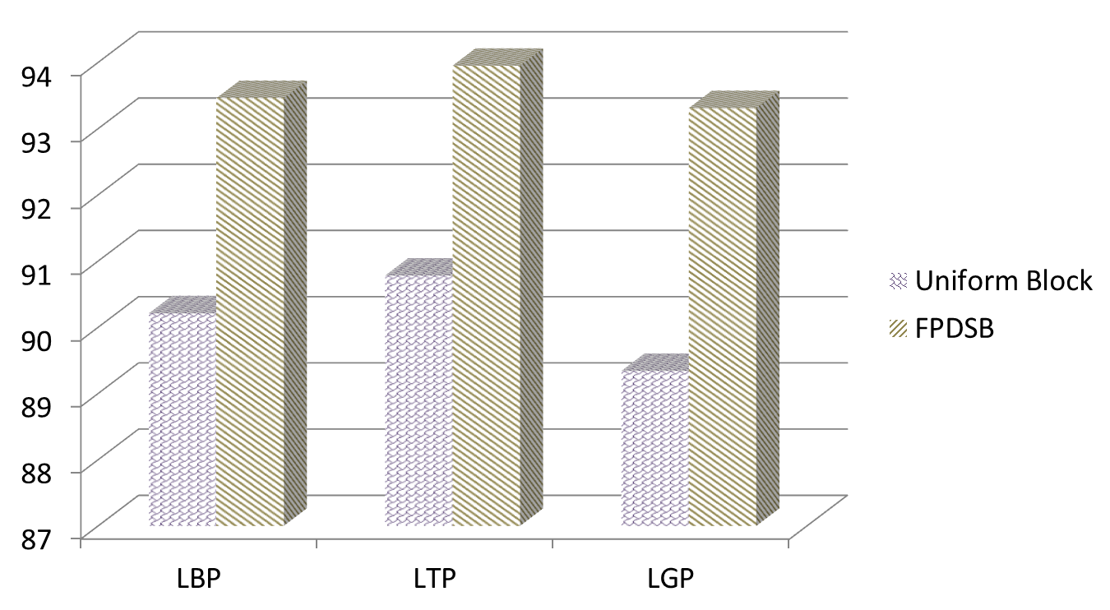
Gender Recognition Result (cont.)
Recognition rate increased over 3.5%
Figure 12: Gender Recognition accuracy (8×8 FPDSB)

Slide 26
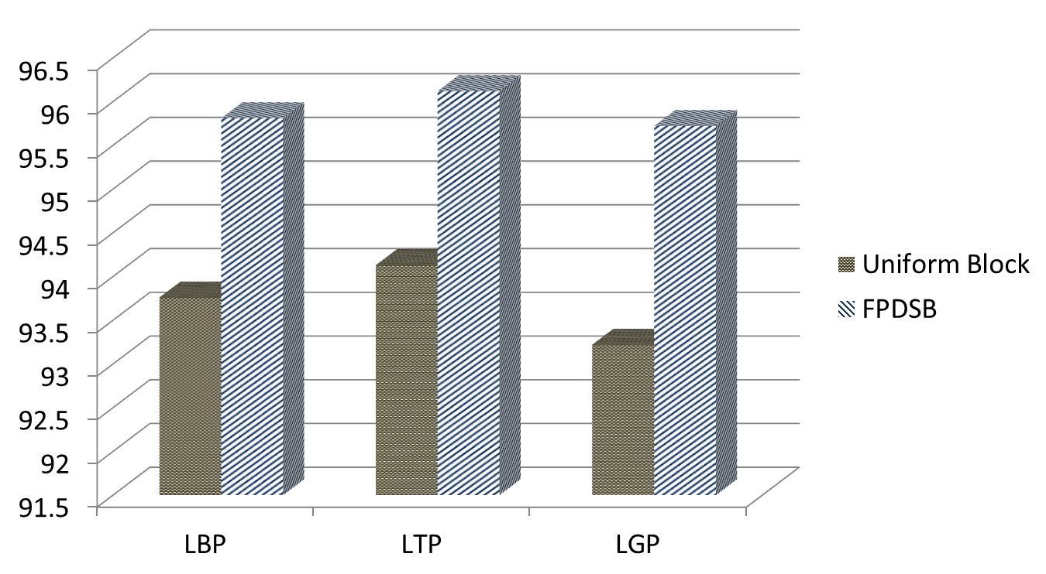
Gender Recognition Result (cont.)
Figure 13: Gender Recognition F-measure (8×8 FPDSB)

Slide 27
Publication
Shanto Rahman, Md. Mostafijur Rahman, Khalid Hossain, Shah Mostofa Khaled, Dr. Mohammad Shoyaib, "Image Enhancement in Spatial Domain: A Comprehensive Study", International Conference on Computer and Information Technology (ICCIT), 2014 (accepted).

Slide 28
Conclusion
Our proposed FPDSB performs well on real life images in uncontrolled situation.
Female recognition rate is significantly increased
This blocking scheme can be implemented for many other facial image based recognition systems.
This blocking scheme can be implemented using our own feature descriptor.

Slide 29
Q & A
Any Question?

Slide 30
References
[1] http://www.prnewswire.co.uk/news-releases/facial-recognition-market-to-see-277-cagr-to-2018-analysis-of emotion-thermal-mobile-forensic-2d-3d-and-cloud-based-facial-recognition-273373811.html

